Slide 1
MLSA INTERNSHIP
NAME- SARVAGYA PRATAP SINGH
BRANCH- COMPUTER SCIENCE YEAR- 3rd
ROLL NO-2200290120149

Slide 2
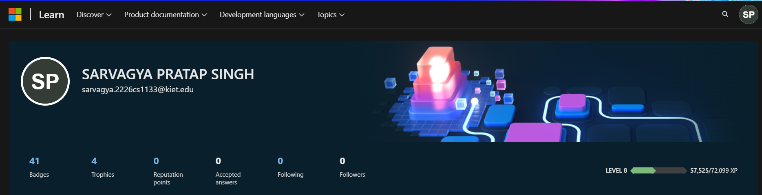
BADGES/TROPHIES

Slide 3
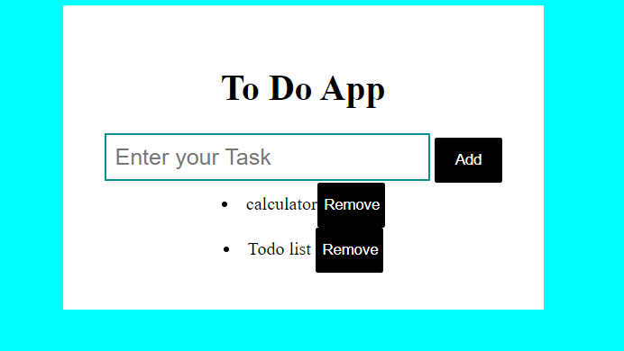
PROJECT-1 To-Do List(Easy Level)

Slide 4
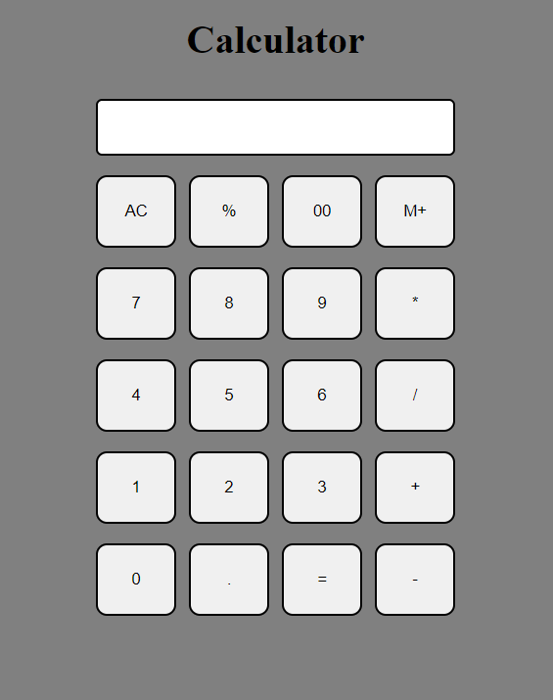
PROJECT-2 Calculator

Slide 5
Thank You

